Slide 1
9 to 5
Dolly Parton

Slide 2
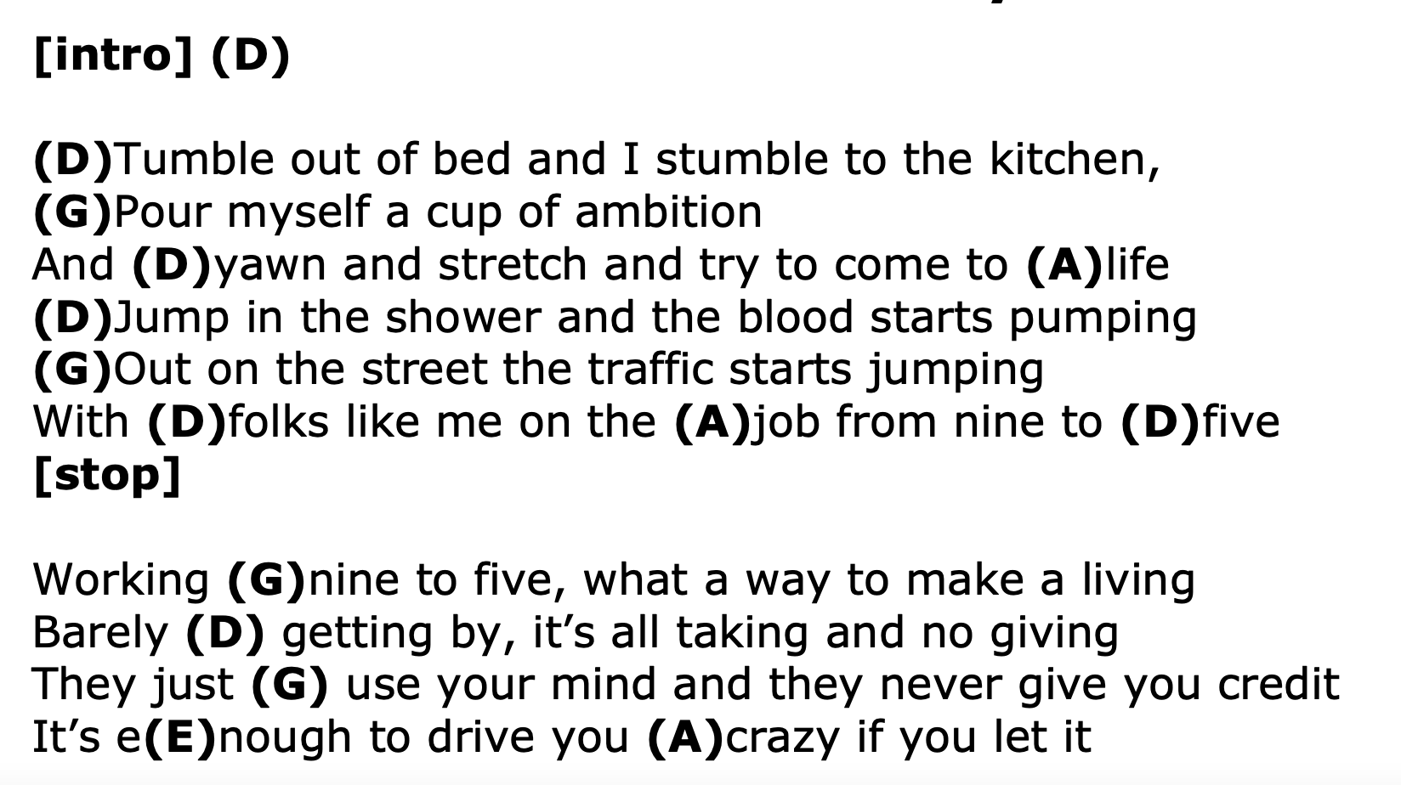
9 to 5

Slide 3
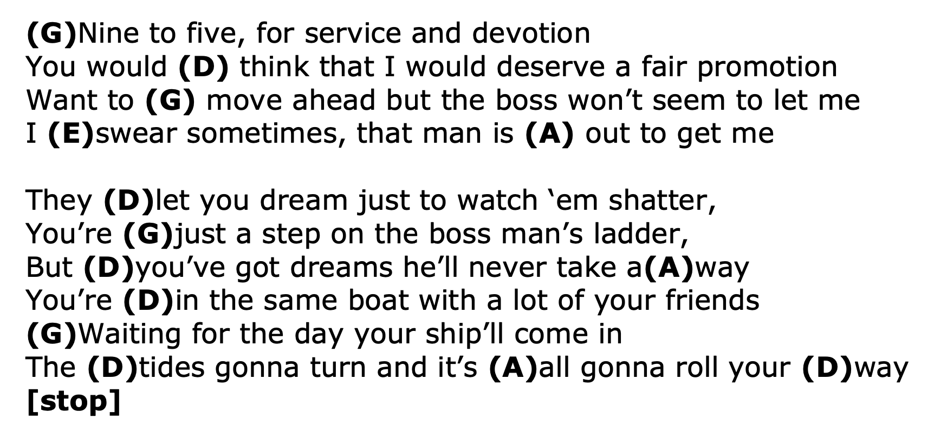
9 to 5

Slide 4
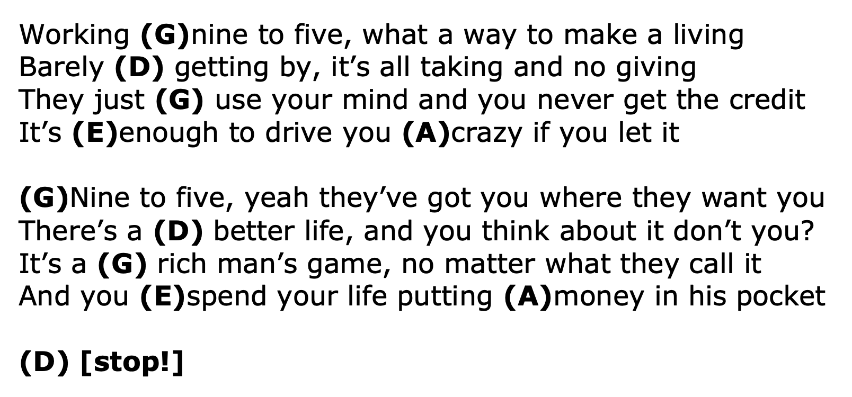
9 to 5

