Slide 1
Hotel California
The Eagles

Slide 2
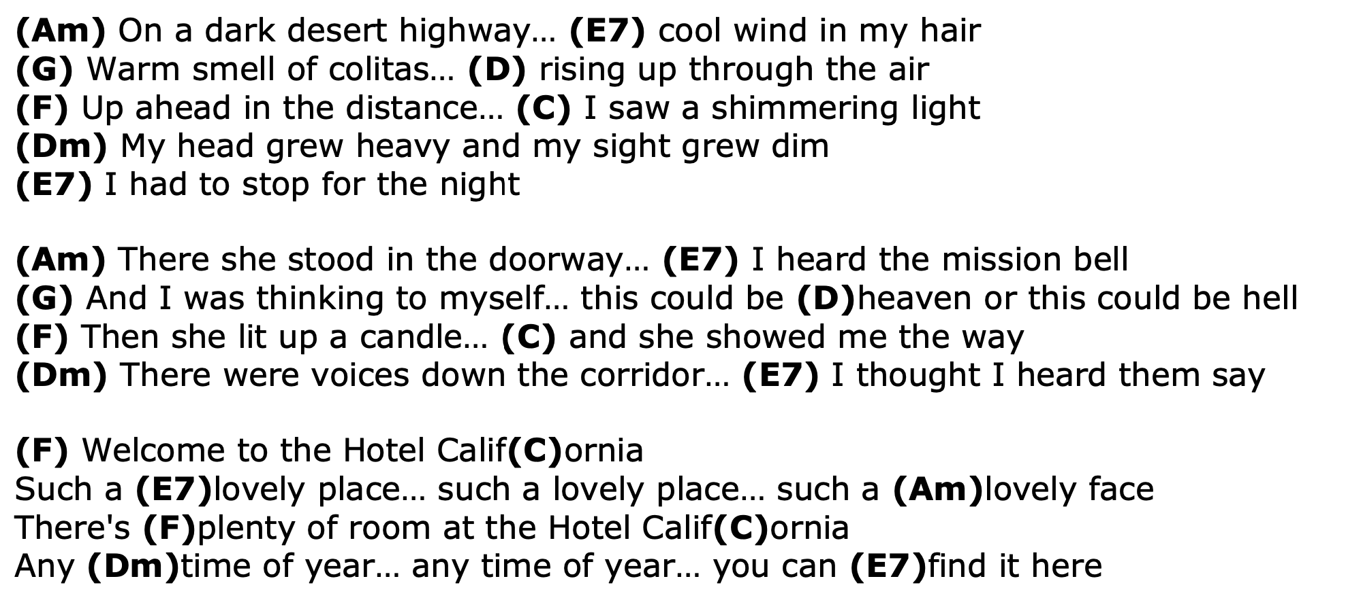
Hotel California

Slide 3
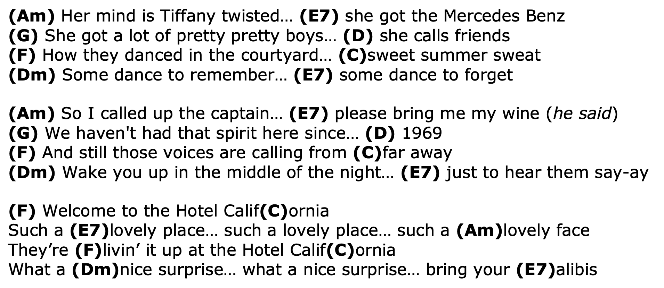
Hotel California

Slide 4
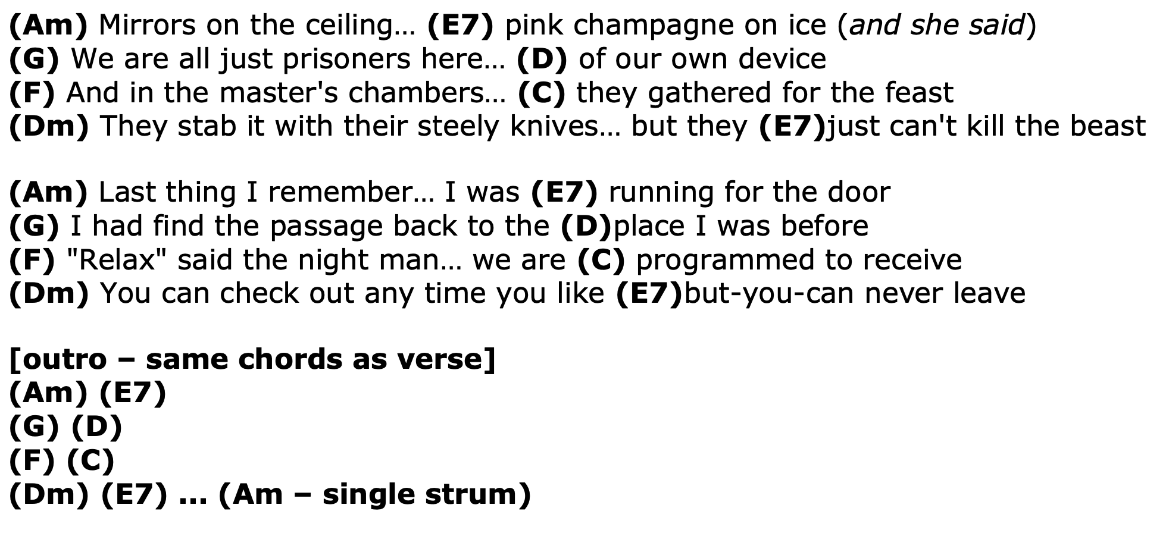
Hotel California

